Slide 1
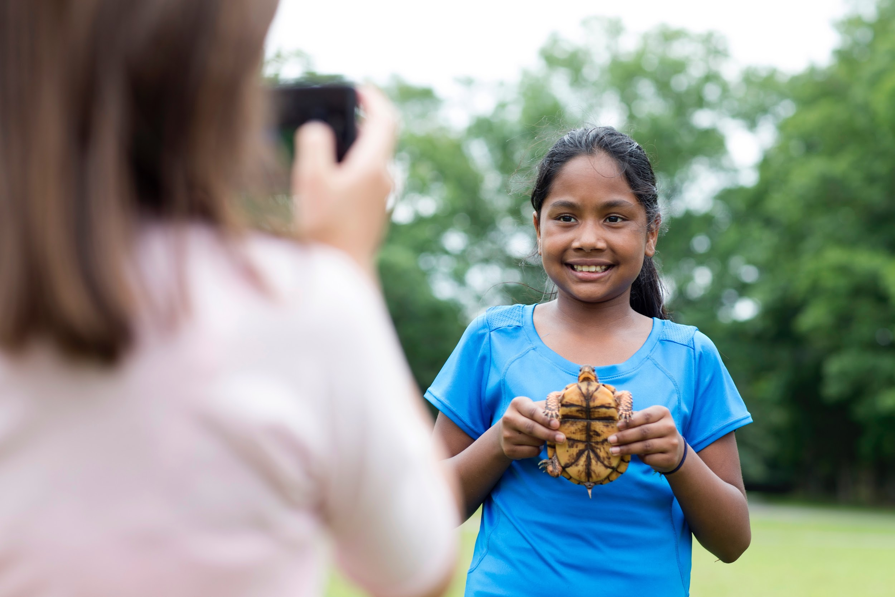
Volunteer Training: K – 5 Outdoor STEM
Think Like a Citizen Scientist Journey
August 2017
Notes:
Hello, everyone, and welcome to our train-the-trainer webinar for the Think Like a Citizen Scientist Journey!

Slide 2
Presenters
Suzanne Harper
Senior Director, National STEM Strategy
Girl Scouts of the USA
Darlene Cavalier
Founder, SciStarter
Sharon Karasick
Project Director, SciStarter
Girl Scout Volunteer
Notes:
I’m Suzanne Harper, senior director of national STEM strategy.
As you may know, we partnered with SciStarter, an online site focused on citizen science, to create this Journey.
I’m delighted to be able to welcome two co-hosts of this webinar: Darlene Cavalier, the founder of SciStarter, and Sheri Karasick, the project director of SciStarter and a Girl Scout volunteer who served as a troop leader for ten years!

Slide 3
AGENDA
What is Citizen Science (Darlene Cavalier)
STEM Journey Structure​ and Activities (Suzanne Harper)
Volunteer Toolkit (VTK) (Suzanne Harper)
Girl Scouts & SciStarter (Darlene Cavalier and Sharon Karasick)
Questions?​
Notes:
Here’s a quick look at what we’ll be talking about today.
Darlene will ground us in what citizen science is and what girls will learn from doing citizen science.
I’ll go through the new STEM Journey structure and the specific activities girls will do on this Journey. I’ll also show you where you can find all the resources for the Journey on the Volunteer Toolkit, also known as the VTK.
Darlene and Sherri will then take you through the SciStarter site. We’re very excited to show you how SciStarter has created a customized section of their site that’s just for Girl Scout volunteers and girls.
And finally, we’ll take questions.

Slide 4
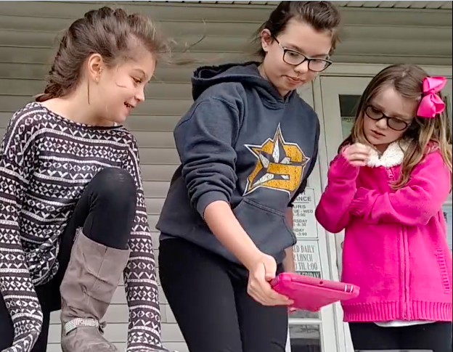
Training Outcomes
By the end of this training,
you’ll understand:
how the new STEM Journeys are structured and what the content is​
what citizen science is
how to use SciStarter
how to facilitate the Think Like a Citizen Scientist Journey

Slide 5
WHAT IS CITIZEN SCIENCE?
Think Like a Citizen Scientist
Notes:
So, let’s get started!
I’m going to turn the presentation over to Darlene, who will talk about what citizen science is and what girls will learn when they do a citizen science project.

Slide 6
What is Citizen Science?
Citizen science is a way for everyday people to help scientists do research.
When scientists need a lot of data, they ask for the public’s help.
People sign up to collect data by doing activities such as taking photos of clouds or streams, documenting changes in nature, or even counting visible stars to help scientist learn about light pollution.
Then they send the scientist their data. The scientist analyzes the information and uses it to better understand the world.

Slide 7
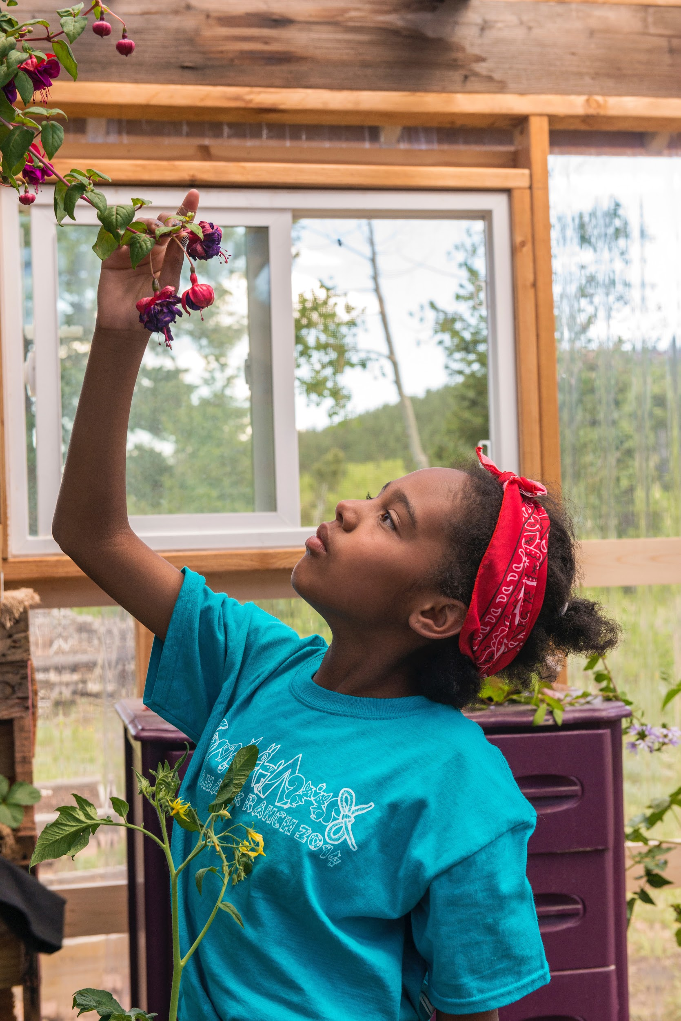
What will girls learn?
How scientists study the world to learn new things
How their citizen science projects will help real scientists answer important questions
That anyone can participate in science — and have fun doing it!

Slide 8
STEM JOURNEY STRUCTURE
AND ACTIVITIES
Think Like a Citizen Scientist
Notes:
Now let’s take a look at the new STEM Journey structure and what girls will do on this Journey.
First, I wanted to give you some background on the new Journey structure. We have heard many suggestions from volunteers about how the Journeys could be made simpler and easier to use.
We did extensive testing of this new structure to see if volunteers found it easier.
The first version was created last summer and tested with a committee of council staff and some volunteers. We got great feedback.
Based on that feedback, we created version 2.
Version 2 was tested with 94 troops and 1,165 girls. Again, we got great feedback about how to make it even simpler.
We took that feedback and revised the Journeys a third time. That is how we developed the structure I’m about to show you.
Also, a note: the Outdoor Journey has a different structure, because it’s badge-based. For the Outdoor Journey, girls do 3 outdoor badges and a Take Action project. Let’s keep it simple: On every Journey, girls learn about a topic they’re interested in and they Take Action to make the world a better place.

Slide 9
STEM Journey Design
Meeting 1 - 3 | Meeting 4 - 5 | Meeting 6
As Girls Arrive | As Girls Arrive | As Girls Arrive
Opening Ceremony | Opening Ceremony | Opening Ceremony
STEM Activity | Plan + Do Your Take Action Project | Celebration
Closing Ceremony | Closing Ceremony | Closing Ceremony
Notes:
Here are a few things to note:
We had 12 - 15 meetings in the original Journeys. Now we have 6.
We had many activity options in the original Journeys. We certainly heard from volunteers who liked having the choice, but many more volunteers said it was confusing. In addition, we had feedback that there was never enough time in troop meetings to use the meeting plans as written. So we’ve trimmed everything down -- and tested these designs to make sure they worked.
Now, as you can see:
Every meeting has four activity slots.
The first 3 meetings focus on the STEM content. There’s an “as girls arrive” activity that ties to the STEM theme. An opening ceremony where girls pledge the flag, recite the Promise and Law, conduct troop business and are introduced to the STEM activity. Then they do the STEM activity, followed by a closing ceremony. Each STEM activity takes 45 minutes (or 30 minutes for Daisies).
The next 2 meetings have the same structure, but they’re focused on the girls’ Take Action project.
Finally, there’s a celebration meeting.
These meetings were designed for the troop meeting model, since that is the most common way K – 5 girls get together.
However, this is a modular structure, so you can customize the way you deliver it. For example, The 3 STEM meetings could be done in day-long workshop or as part of day camp. Some troops may want to have a meeting to celebrate their achievement and have an awards ceremony. Others may want to use one of their meetings to celebrate many things they’ve accomplished.
What’s most important is making sure that girls learn about citizen science, do a Take Action project and have fun.

Slide 10
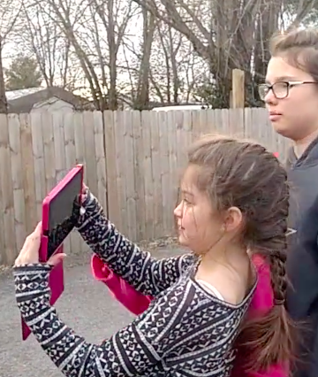
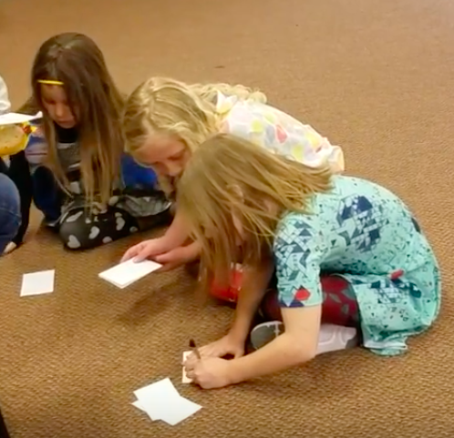
Daisy Activities
Meeting 1: Animal Role-Play
Meeting 2: Butterfly Field Notes
Meeting 3: Citizen Science Project
Notes:
In the first meeting, Daisies are introduced to citizen science. They learn why it's important for scientists to observe the world closely. And they develop their own observation skills through hands-on activities.
As Girls Arrive: I Spy
STEM Activity: Role-play an animal. How would they see the world differently?
In the second meeting, Daisies learn to collect and analyze data. Sounds pretty advanced for Daisies -- but this is such a fun activity!
As Girls Arrive: Create your field notebook
STEM Activity: Butterfly field notes- You’ll find handouts in your program materials. The handouts have illustrations of two kinds of butterflies with different patterns. You post the illustrations around the room. Girls collect data -- meaning that they count the butterflies and how many different patterns they can spot.
As part of Meetings 1 & 2, you’ll also be introducing girls to the citizen science projects found on your SciStarter. In the second meeting, girls will choose the project they want to do.
In the third meeting, Daisies do the citizen science project they chose.
A couple of notes on these activities:
The citizen science project is done outdoors, but you can do take any of these activities outside if you want.
There are talking points in all the meeting plans. girls will learn about what Take Action is and talk about what kind of project they want to do during the opening or closing ceremonies. That prepares them to decided on a Take Action project by the third meeting.

Slide 11
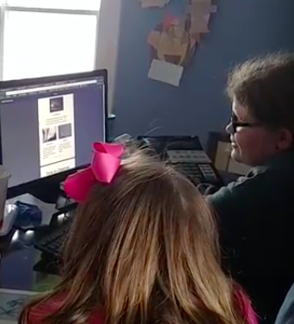
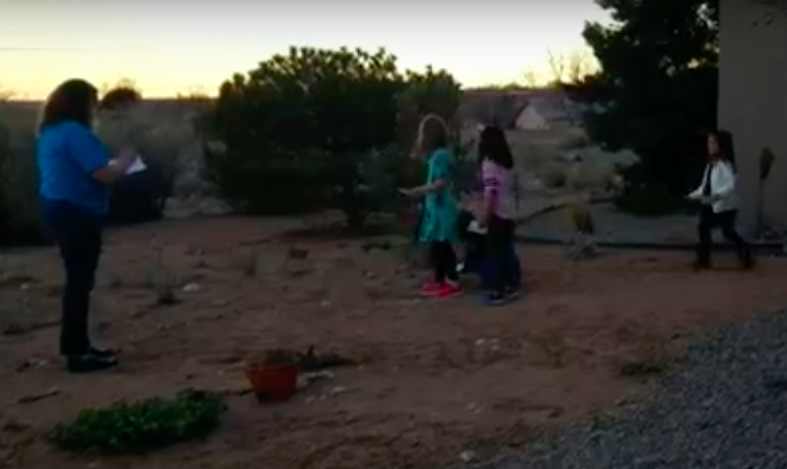
Brownie Activities
Meeting 1: Sharpening Our Observation Skills
Meeting 2: Snails Field Notes
Meeting 3: Citizen Science Project
Notes:
In the first meeting, Brownies sharpen their observation skills through hands-on activities. They learn how scientists use observation to understand the world.
As Girls Arrive: Quick changes, clothing, hair, take off glasses.
STEM Activity: Kim’s Tray
In the second meeting,
As Girls Arrive: Create your field notebook
STEM Activity: This is similar to the butterfly activity that Daisies did, but it’s been aged up. There are illustrations of snails with different and more complex patterns. Not only do Brownies count them and take notes on how many types of snails there are, but they also create a map of where the snails were found as a way to present their data. (Just to be clear: If you post the snail pictures around a meeting room, Brownies will make a simple map of the room and plot where they “found” the snails.)
As part of Meetings 1 & 2, you’ll also be introducing girls to the citizen science projects found on your SciStarter. In the second meeting, girls will choose the project they want to do.
In the third meeting, Brownies complete their citizen science project and choose their Take Action project.
These activities are also used in the Multi-Level Think Like a Citizen Scientist Journey, with tips and notes to volunteers on how to age up/age down the activities to fit their girls’ age and experience level. I think you can see how the activities match up across the grade levels when we get to our next slide, which shows the Junior activities.

Slide 12
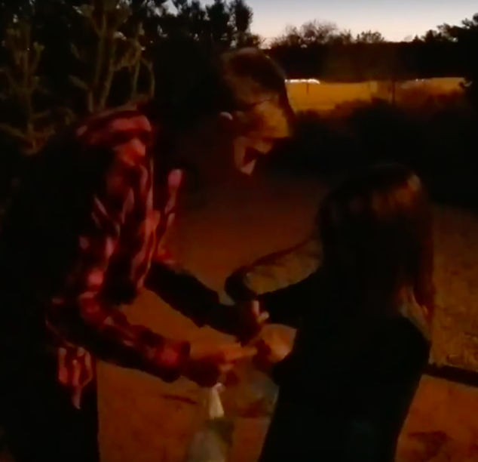
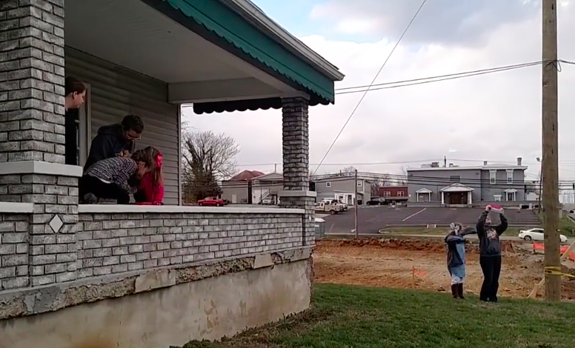
Junior Activities
Meeting 1: Observing with Detail & Precision
Meeting 2: Animal Tracks Field Notes
Meeting 3: Citizen Science Project
Notes:
In the first meeting:
As Girls Arrive: Sensing Nature (making observations about natural objects- warm up activity to learn about observing)
STEM Activity:
Kim’s Tray
Describe Your Observations (i.e. how can you describe different seashells with enough detail that your partner can guess which item you chose?)
Make scientific observations about the room (learn what makes an observation scientific or not)
In the second meeting:
As Girls Arrive: Create your field notebook
STEM Activity: Juniors take field notes about animal tracks and learn about collecting and analyzing data over time. Again, this is similar to what Daisies and Brownies do, instead of collecting data on butterflies and snails, Juniors are looking at different animal tracks and plotting them on a map. There’s an added level to the activity that teaches girls to plot a graph of data changing over time.
As part of Meetings 1 & 2, you’ll also be introducing girls to the citizen science projects found on your SciStarter. In the second meeting, girls will choose the project they want to do.
In the third meeting, Juniors complete their citizen science project.
I mentioned earlier that we tested the Journey structure in the fall as part of our engineering pilot.
We also tested the Think Like a Citizen Scientist Journey with volunteers and girls.
We revised based on their suggestions. I wanted to share some of the overall comments from volunteers.

Slide 13
Volunteer Feedback
“The girls loved it and it was simple. Not a lot of planning or extra work had to go into this.”
"Great how it ties into Girl Scout ethics of doing things for their community."
“Girls saw they could contribute as kids, it's not just adult stuff."
“Girls loved the idea that they can truly make a difference in this world through the field of science.”
“This was not like anything else girls have done. It was great for them to think outside the normal box.”
Notes:
Ø Content tested with 5 Cadettes and 47 K-5 girls in Multi-Level Troops
We were so happy with these comments.
Not a lot of planning or extra work needed!
Girls saw they could contribute to science, even though they’re kids
It wasn’t like anything else they’ve done.
Citizen science ties into Girl Scout values.
And, of course, the last quote, which is the outcome we want for all girls who go on this Journey: Girls loved the idea that they can truly make a difference in this world through the field of science!
I’d like to add my favorite story from our citizen science testing. One volunteer said she had tried to get girls interested in a local STEM event, but they were lukewarm about going. After they did their citizen science project, not only did they say they wanted to go to the STEM event, but they also started talking, with great excitement, about how they should organize a citizen science day at their school!
When you look at the new STEM outcomes we’ve developed, you’ll see that we want girls to benefit in 4 ways. We want to increase 1) their interest in STEM; 2) their confidence that they have what it takes to do STEM; 3) their competence in STEM, meaning that girls will have more knowledge about STEM and developed STEM skills; and 4) their understanding that STEM is of value to society. Scientists help people, help animals, help the planet. The volunteers who were gracious enough to test this program delivered on every one of those outcomes -- so kudos to them!

Slide 14
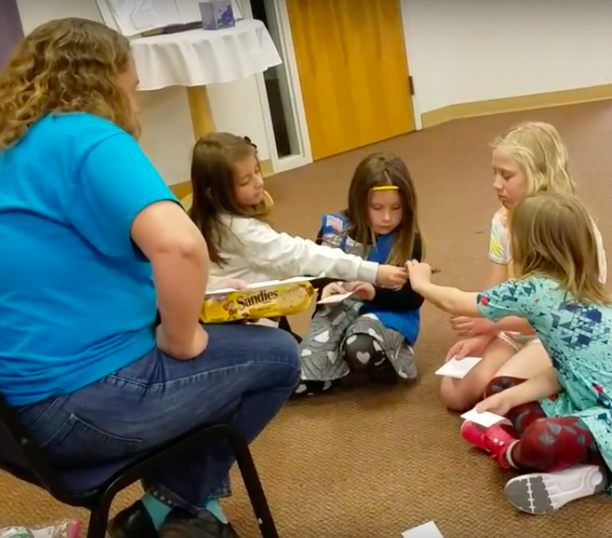
How do you teach Citizen Science?
Use The Talking Points (But Make Them Your Own).
Be Prepared (It’s What Girl Scouts Do).
Use Girl Scouts’ Three Processes.
Observe. Record Data. Analyze Data.
Leave Time For The Closing Ceremony.
Tell Your Troop Story.
Consider the Program Pairing.
Notes:
You’ll find all this information in the meeting plans on VTK!
Use The Talking Points (But Make Them Your Own) Some volunteers find it helpful to follow the script. Others deliver the information in their own words. Either way is just fine.
Be Prepared (It’s What Girl Scouts Do!) Each meeting includes a “Prepare Ahead” section that includes a materials list and what kind of set-up is required. Read it in advance so you have enough time to gather supplies and enlist help, if needed.
Use Girl Scouts’ Three Processes“Learning by doing” and “cooperative learning” are built into this Journey, thanks to the hands-on activities and tips. You’ll also find specific “keep it girl-led” tips in the meeting plans to help you create a girl-led experience.
Observe. Record Data. Analyze Data.: Girls will do hands-on activities to learn about the scientific method. They'll learn how to observe closely, record their observations and analyze what they've learned. They'll then put what they've learned into practice by doing a citizen science project. When they send in the data they collected, girls are doing something very important. Their data will help a real-life scientist to do real-life research. They will join thousands - even millions! - of other people who also did the project and sent in their data. That's how science works - gathering millions of pieces of information and then figuring out how it all fits together. And it all starts with observing, recording and analyzing data.
Leave Time For The Closing Ceremony: If girls are having fun, you may be tempted to skip the Closing Ceremony so they can keep going — but the Closing Ceremony is absolutely key to their learning.
Here’s why: When girls leave the meeting, they’ll remember how much fun they had, but they may not realize that they just learned how engineers solve problems or that they’re good at science — unless you tell them.
The Closing Ceremony is where you can connect the dots for girls by pointing out:
how they acted as citizen scientists.
how much fun they had solving problems with science.
that they have what it takes to continue exploring STEM.
Tell Your Troop Story: As a Girl Scout leader, you’re designing experiences that girls will remember their whole lives. Try to capture those memories with photos or videos. Girls love remembering all they did — and it’s a great way for parents to see the benefits of Girl Scouting. And please help us tell the Girl Scout STEM story by sharing your photos and videos with us! Email them to STEM@girlscouts.org (with photo releases, please!).
Program Pairing: When possible, we’ve listed badges that pair well with each Journey. Here are the suggested program pairings for Think Like an Engineer:
Daisy: Clover petals
Brownie: Bugs, Hiker, and Outdoor Adventurer badges
Junior: Camper, Animal Habitats, and Flowers badges
If you had other pairings that worked well, let us know!

Slide 15
VOLUNTEER TOOLKIT (VTK)
Think Like a Citizen Scientist
Notes:
Now we’re going to do a quick, high-level tour of the program materials on VTK.

Slide 16
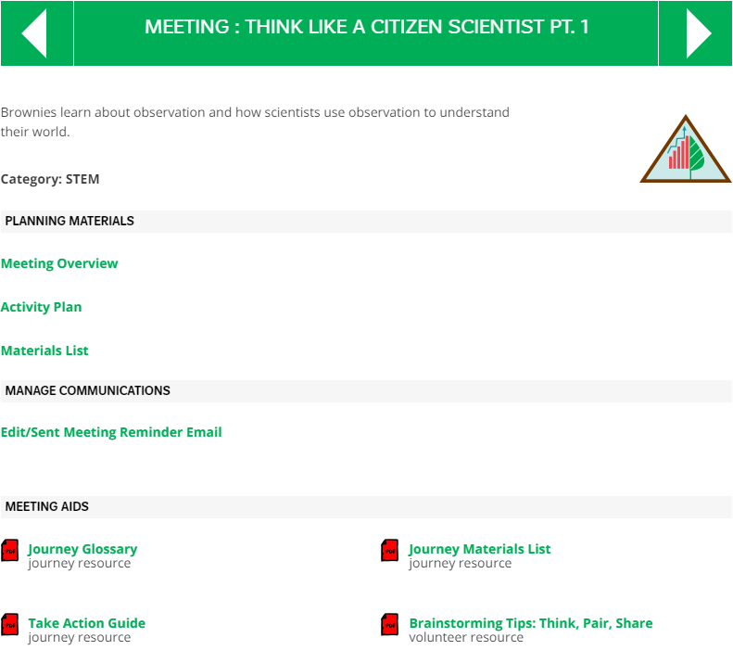
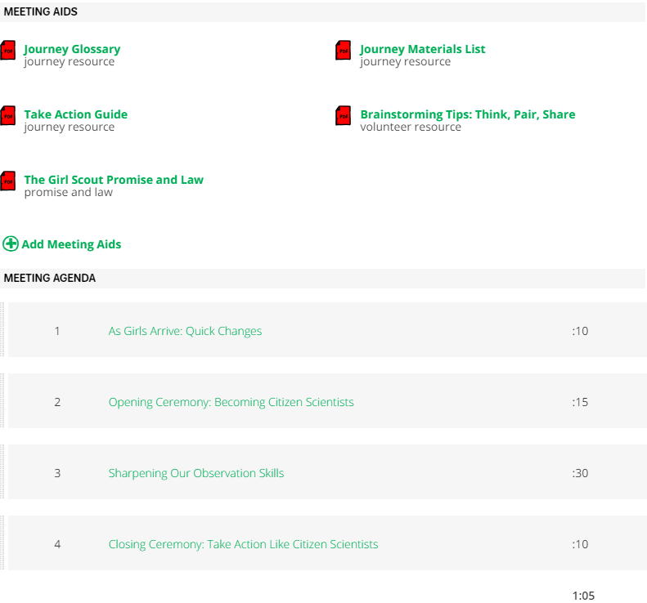
Volunteer Toolkit (VTK)
The Meeting Overview includes:
Facilitation Tips
Prepare Ahead Checklist
How to Use Your Network
Time
Materials for the activity
Take Action Guide (Journeys only)
Glossary
Materials List (for entire program)
Handouts to be used in specific meetings
Award Connection
Meeting Length
Program Pairing
Step-By-Step Directions, including Talking Points (SAY)
Brainstorming Tips: Think, Pair, Share
Girl Scout Promise & Law
For Multi-Level: Benefits of Having a Multi-Level Troop
The Activity Plan includes:
The Materials List lists materials for the Meeting.
The Meeting Aids include:
Notes:
On the left side of the screen, you’ll see a list of all the materials that have been created to support this Journey. On the right, you’ll see a screenshot that shows where they are located.
You have detailed activity plans for each meeting, checklists, facilitation tips, handouts that go with each meeting, a glossary, a Take Action guide, and materials lists (both a list for each meeting AND a list of all the materials you need for all 6 meetings, in case you like to pull them together all at once).
This is why VTK is a useful tool. If you go here, you’ll know that you have all of the resources you need. The activity plans are great for step-by-step instructions, but some of the handouts you need are actually in the meeting aids section.
Let’s take a closer look at the meeting aids for this Journey.

Slide 17
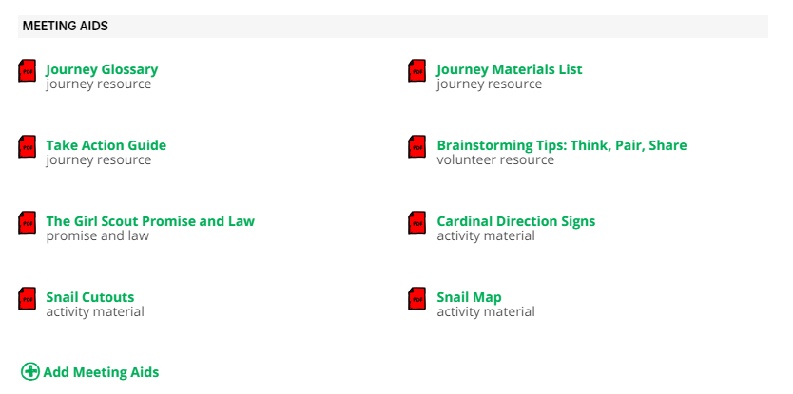
VTK: Meeting Aids
Notes:
You can see that you have some standard aids, like a Promise and Law handout, which is especially useful for new volunteers.
You have the glossary and materials list.
See the document called Brainstorming Tips: Think, Pair, Share? That’s a great handout with facilitation tips that Audrey Kwik and Jesse Mostipak at NE Texas created for us.
And pay attention to that Take Action Guide! This is something we’ve heard loud and clear from volunteers: Help me understand the difference between community service and Take Action — and what it means to make a project sustainable. Give me some examples of Take Action projects — my girls want to come up with their own project, but they need help getting started. You’ll get all that in this Take Action guide, so check it out.
And finally, notice these meeting aids. These handouts are used in Meeting 2 of the Brownie Journey. You need them to facilitate the meeing.
We take feedback seriously. We’ve tested and revised the Journeys to address feedback from girls and volunteers. We’ve created new meeting aids based on volunteer requests. If we hear that there’s a need for a new meeting aid, we can create it and add it to VTK. That’s another reason to use this online tool!

Slide 18
VTK: Survey feedback
We want to hear from you!
Girls and volunteers can share their feedback on the program.
Girl Survey - Available via URL link in Prepare Ahead and as an Activity in the Activity Plan. A PDF version of the survey will also be available under “Meeting Aids.”
Volunteer Survey - Available via the button at the end of the Meeting Plan for Think Like a Citizen Scientist Pt. 6
**Note: The surveys links will go live in September 2017.**
Notes:
Here’s another way we ask for feedback from girls and volunteers. At the end of each program, we have a link to a survey for girls and a survey for volunteers.
The girl survey helps us measure how well the program is working. If girls are bored or not achieving the intended outcomes, that means we have work to do. We need to revise the program. We know that it takes time for girls to fill out a survey and that it can be challenging to get a roomful of girls to do this. But if you can, we’d greatly appreciate it. It will help us improve the program, which will benefit the Movement and, most important, benefit girls.
We’d also like you to complete the Volunteer Survey, which you can find at the end of the Meeting Activity Plan for Meeting 6. By using VTK, you can reach GSUSA directly and make your voice heard.

Slide 19
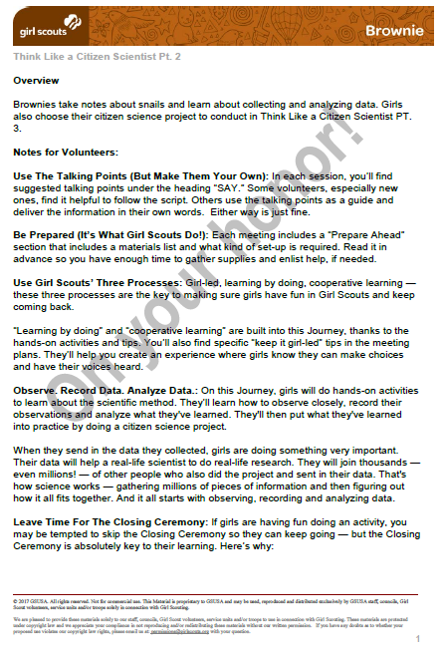
VTK Access
If you don’t have access to the VTK, contact your council.
On 8/25/17, all councils will have access to PDFs of the program.
Each PDF includes:
Meeting Overview
Materials List
Full Activity Plan
Meeting Aids
Notes:
Okay, I’ve given you several reasons to use VTK, but we know that not everyone can access an online site. So we’ve made PDFs of all the program materials. Councils will have those PDFs on 8/25. Please reach out to your council if you need these printed versions.

Slide 20
GIRL SCOUTS & SCISTARTER
Think Like a Citizen Scientist
Notes:
And now it’s time to learn more about the SciStarter site you and your girls will use to do a citizen science project.
I’m really thrilled about this partnership! SciStarter has almost 1,500 citizen science projects to choose from — and the site is designed for children and their caring adults, whether they’re parents or Girl Scout volunteers. As you’ll see, SciStarter created a special section of the site especially for Girl Scouts. We worked closely with them to choose a handful of projects that were best suited for Girl Scouts in terms of the length of the process and the equipment required. We even made sure that there were projects that could be done in any season, keeping in mind that some parts of the country have 70 degree days in February and some have blizzards.
Now I’ll hand off to Darlene, who’ll walk you through the site.

Slide 22
STEP 1: Sign up for your SciStarter account
SciStarter accounts are free.
Troops’ accounts are private and safe.
https://scistarter.com/girlscouts/volunteer/landing
NOTE: This link is for Troop Leaders ONLY! (You’ll receive a special link to invite girls and/or you can manually add names)
Notes:
When you begin the Think Like a Citizen Scientist Journey, you’ll need to sign up for an account with SciStarter to access the citizen science projects curated for the Journey by GSUSA and SciStarter. Use the special link found in your Meeting Overview.
Troops’ accounts are private and safe. They’re linked to Volunteer accounts AND the project selected for each Journey so everyone is participating at the same pace. The accounts make it possible for you, the Volunteer, to guide your troops in their citizen science experiences and track progress such as when they have selected, joined and participated in a project.
Girl Scouts’ SciStarter accounts provide customized, Volunteer-guided experiences throughout the Journey and, after the Journey, unlock access to all types of free features and recommended projects girls can do with their families for years to come.
https://scistarter.com/girlscouts/volunteer/landing <--for Troop Leaders ONLY! (You’ll receive a special link to invite girls and/or you can manually add names)

Slide 23
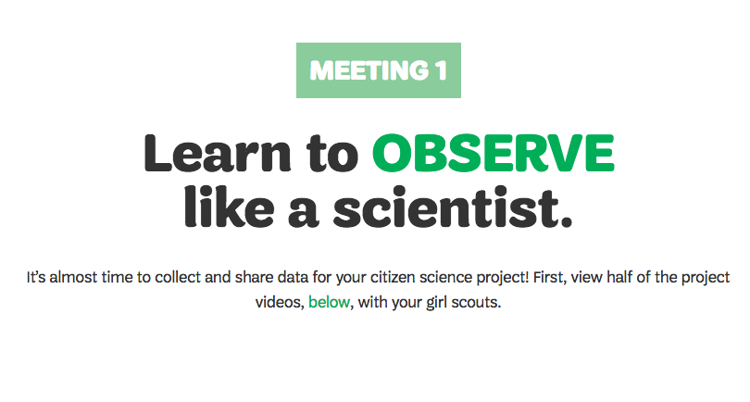
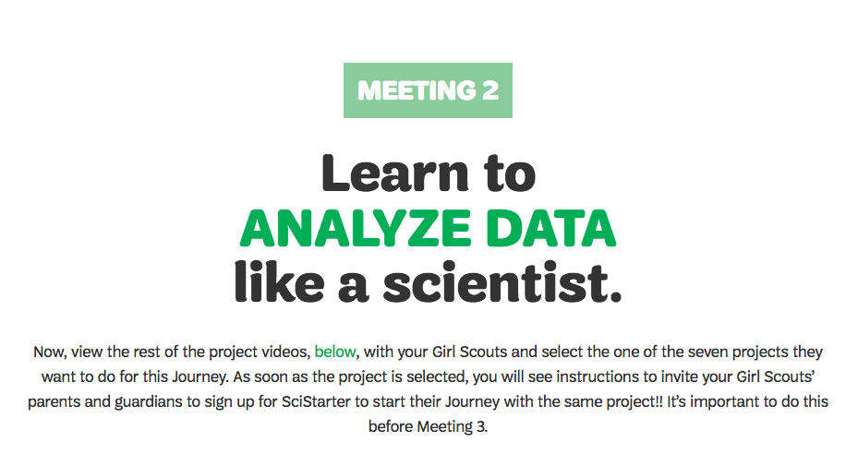
STEP 2: Complete meetings 1 & 2
Prepare girls for their citizen science project!
In meetings 1 and 2, girls will do hands-on activities to learn how to make observations and collect and analyze data.
Notes:
As Suzanne mentioned previously, girls do hands-on activities in the first two meetings to learn how to make observations and collect and analyze data.

Slide 24
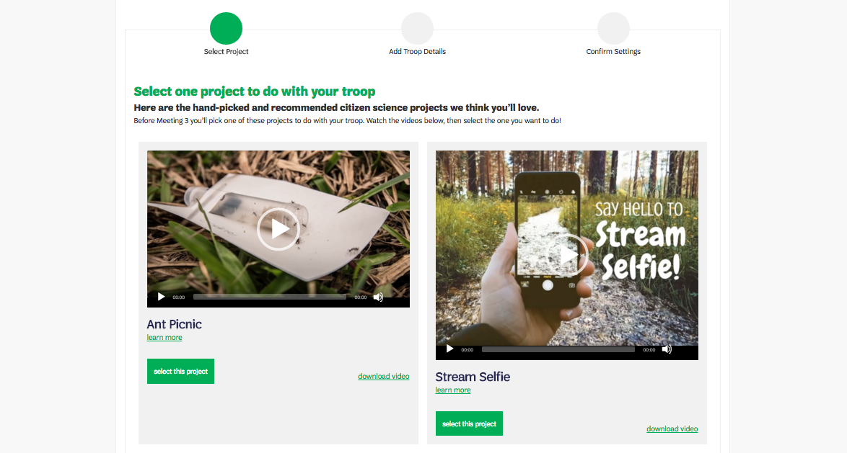
STEP 3: Have girls choose their project
Notes:
As part of Meetings 1 & 2, you’ll also be introducing girls to the citizen science projects found on your SciStarter dashboard. The scientists from each project have recorded a special video to Girl Scouts, telling them about their project and how the girls can help.
Before the meetings, you’ll want to review the videos, and choose a few to show to girls at each meeting. In Meeting 2, girls will choose which citizen science to complete in Meeting 3.

Slide 25
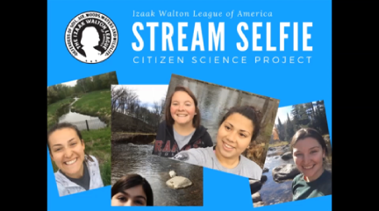
STEP 3: Have girls choose their project
SciStarter includes short videos of scientists describing their projects.
Show them in your troop meeting or ask girls to watch them at home. Let girls lead by choosing the project they want to do.
Notes:
Here’s the introduction video from the Stream Selfie project.

Slide 26
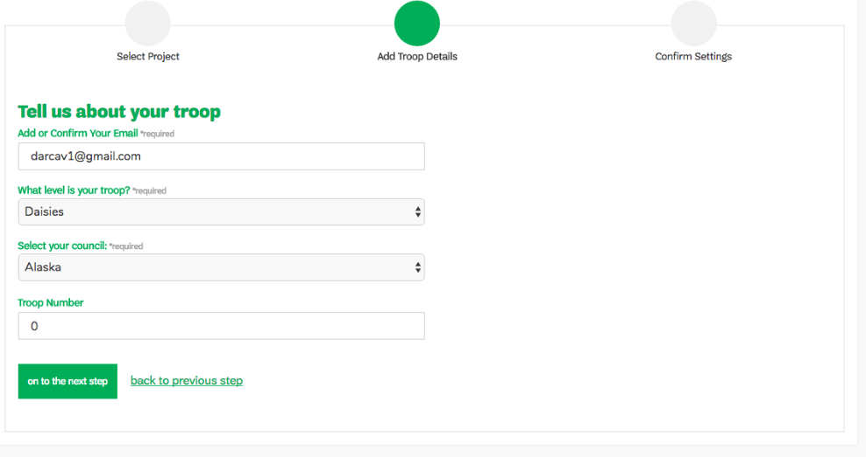
STEP 4: Invite your troop
Notes:
Once your troop chooses a project, select the project and add your troop details to generate your special citizen science URL.
Share this with your troop to allow them to sign up and become part of your citizen science Journey.

Slide 27
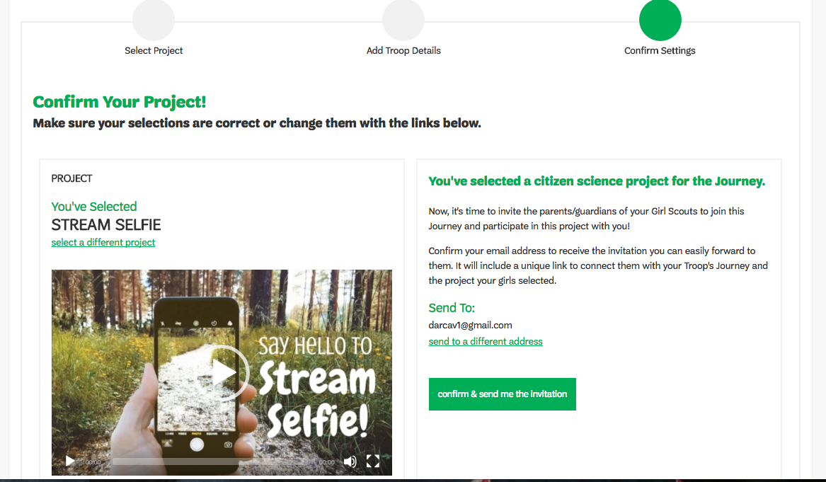
STEP 4: Invite your troop
In one click, confirm the project and generate automated email to invite your troop to sign up.

Slide 28
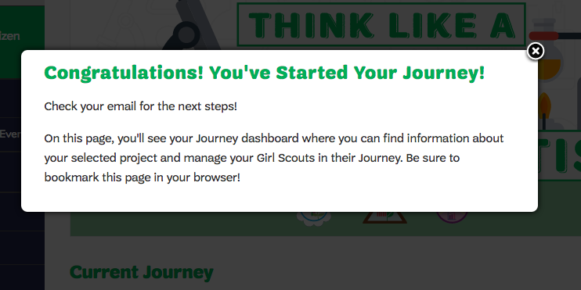
STEP 4: Invite your troop
Notes:
Once you’ve invited your troop, you’ve started your Journey!

Slide 29
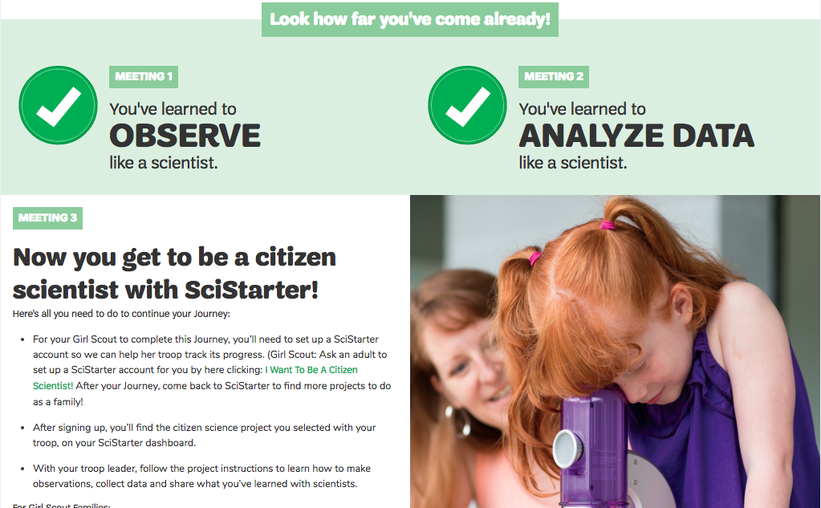
STEP 4: Invite your troop
Girl Scout Sign Up Page
Notes:
Here is what your troop will see when they click on your invitation to sign up for the Journey.
Girl Scouts’ SciStarter accounts unlock customized, guided experiences.

Slide 30
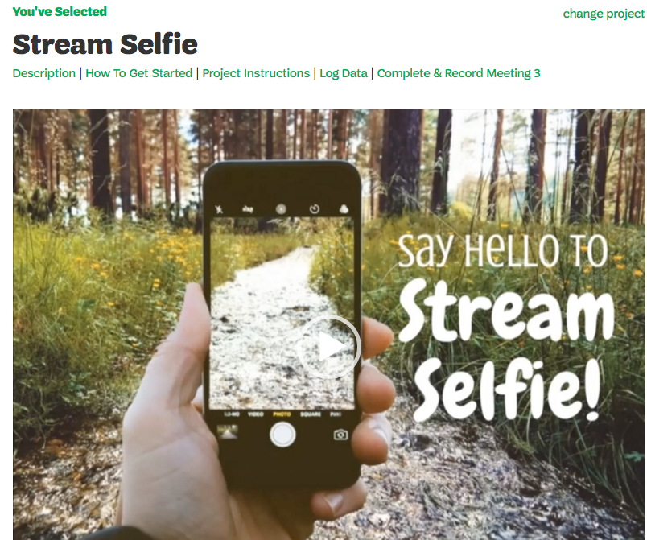
Notes:
After signing up, girls (with their parent’s help and permission) will have access to their own Girl Scouts SciStarter dashboards, already customized with the citizen science project they chose to complete as a troop.

Slide 31
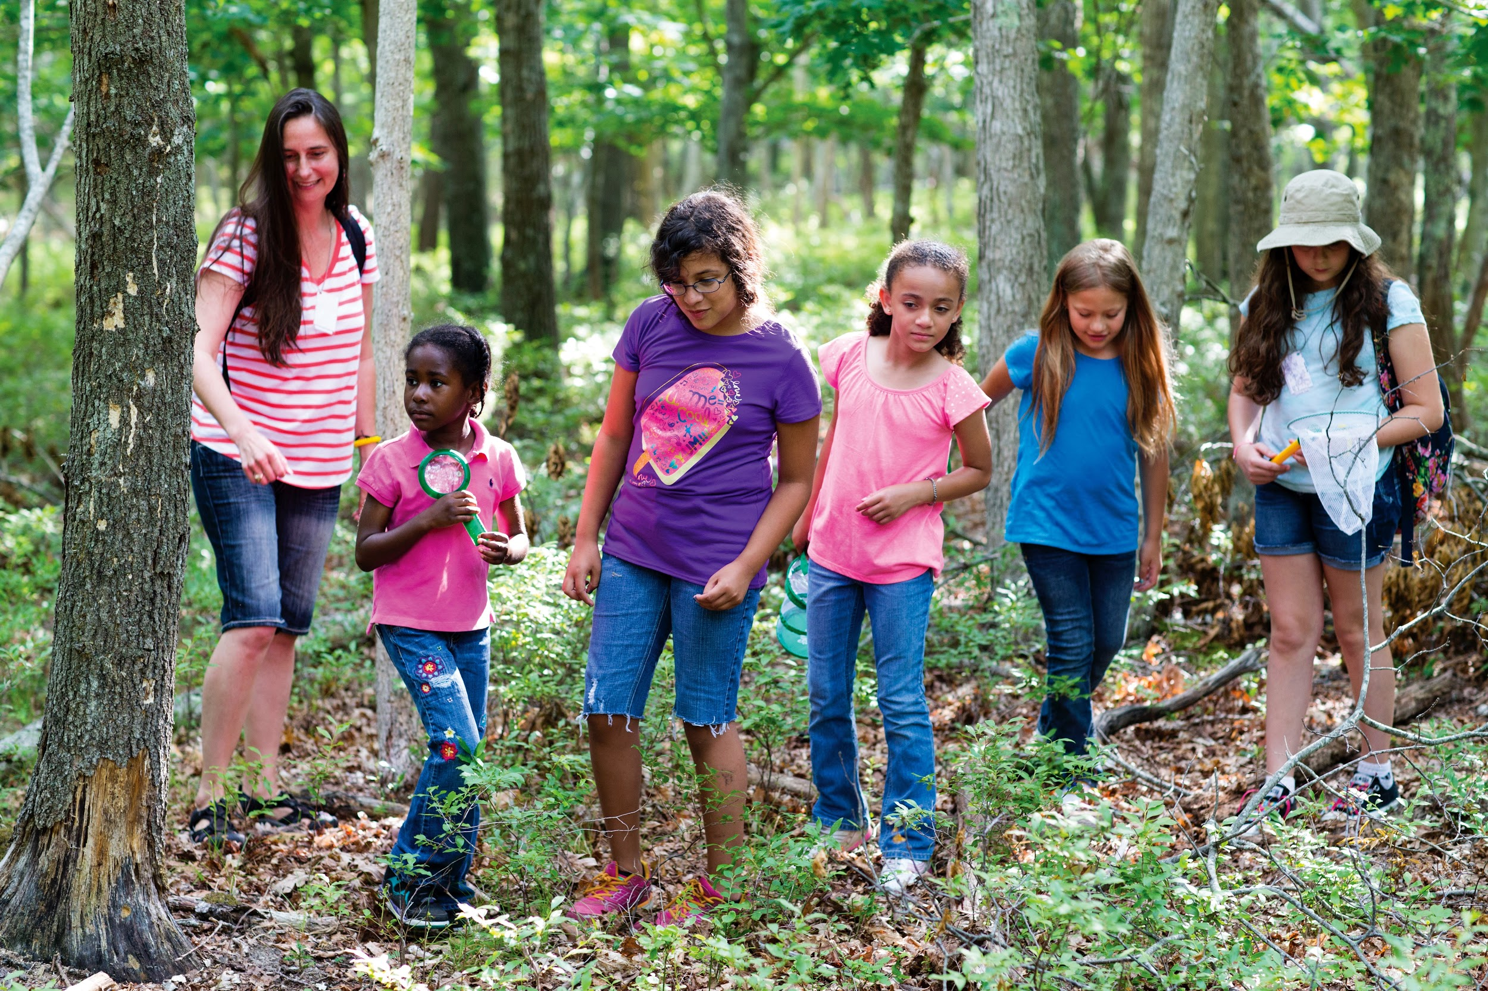
STEP 4: Complete meeting 3
Get outside and do some citizen science!
Notes:
Now it’s time to do the citizen science project!
Review the project instructions and find out what materials you will need (on your SciStarter Dashboard.) Look over any additional materials so you’ll be able to answer questions and guide girls during the activity.
Depending on your girls’ project, you may need a device (to take pictures and upload data), data forms, and other materials.
give examples of the kind of data we’re talking about.

Slide 32
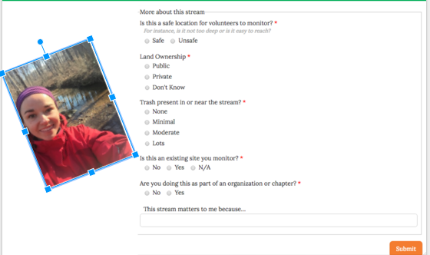
STEP 4: Complete meeting 3
Share the data girls collected with a scientist
Enter girls’ observations on the digital or hard copies of the project’s form using each girl’s response.
Notes:
Log data online or using hard copies of the project’s form.

Slide 33
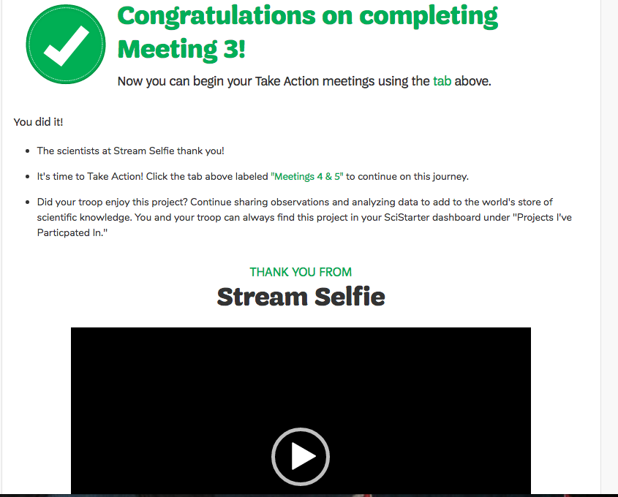
STEP 4: Complete meeting 3
Mark your girls’ attendance for Meeting 3 on your SciStarter Dashboard to unlock Meetings 4 & 5.
Notes:
Log your girls’ and mark your girls’ attendance for Meeting 3 on your SciStarter Dashboard to unlock Meetings 4 & 5.

Slide 34
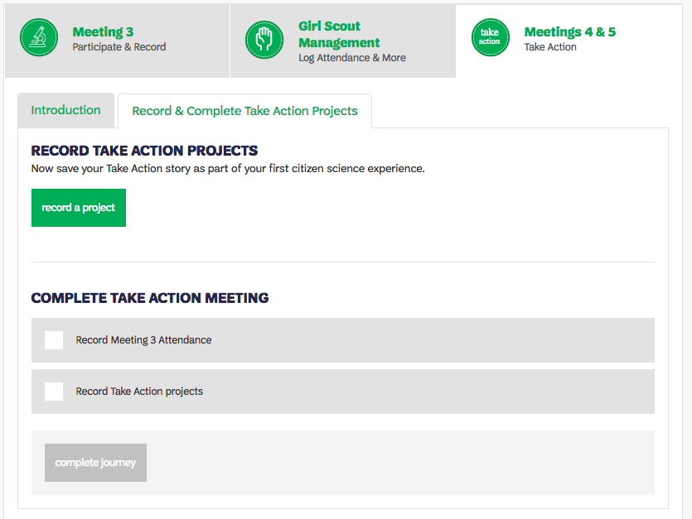
STEP 5: Record your Take Action project
Notes:
In Meetings 4 & 5, girls plan and create their Take Action Project. Following Meeting 5, record your Take Action project on your SciStarter Dashboard to complete your Journey.
Record your Take Action Project by gathering feedback from your troop on three questions:
What problem did the girls want to solve with your Take Action Project?
What was the girls’ solution?
How did the girls make their project sustainable?

Slide 35
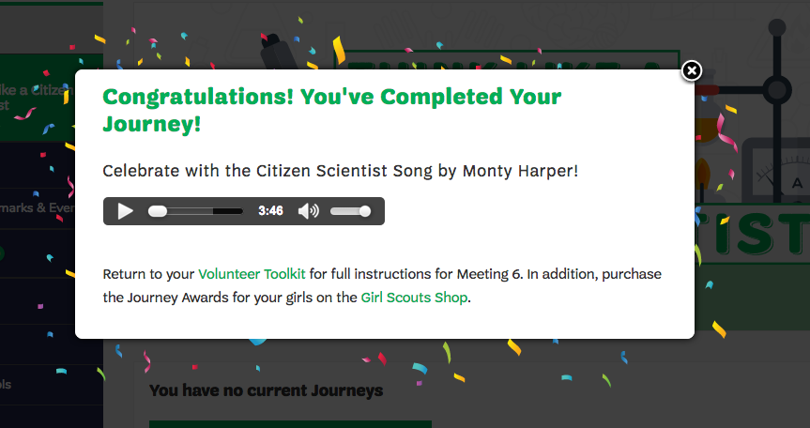
STEP 6: Celebrate
Notes:
After you complete your Journey on SciStarter, navigate back to VTK for the final meeting in the Journey, Think Like a Citizen Scientist Pt. 6.

Slide 36
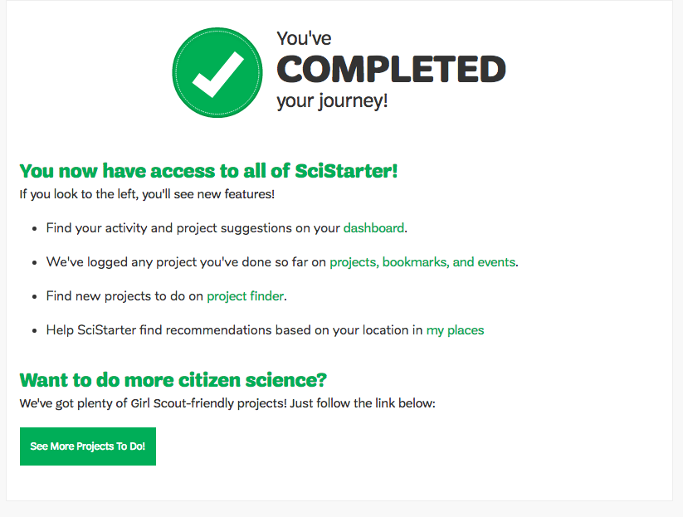
Do more citizen science
Notes:
Once you complete your first Journey on SciStarter, you will have access to all of SciStarter.

Slide 37
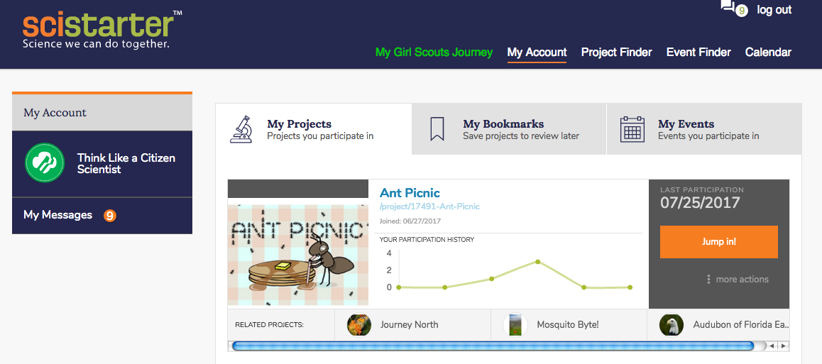
Keep track of all your projects
Notes:
All SciStarter, users have dashboards to track their interests and participation in citizen science projects.Each time you and your troop contribute to projects during and after your Journey, actions are recorded in your dashboard. Encourage your troop and their families to use their dashboards for Community Service hours, for their next Science Fair project, or to find their next project to help scientists answers more questions! You’ll also find recommended projects based on your location, interests and experiences.
Not only are you helping scientists when you use ScIStarter, but you’re helping plenty of researchers who study the field of citizen science: SciStarter,supported by the National Science Foundation, is a platform that makes it possible for researchers to learn more about project design, motivations and learning outcomes of citizen science, primarily through dashboard analytics!

Slide 38
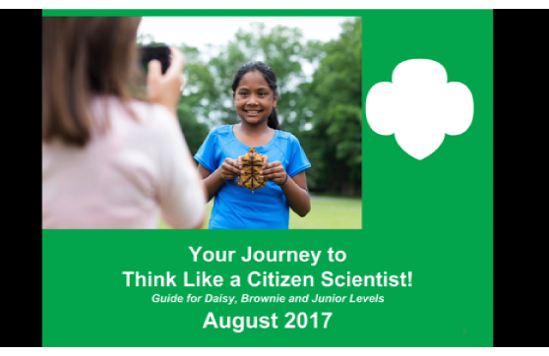
SciStarter Training Video
Notes:
My journey with Citizen Science has been a very adventurous one for myself, my daughters,
and my troop so I am very excited to be a part of this Journey team!
As you will see from this slide, we have created an orientation and training video that
lasts about 10 minutes. It is a comprehensive, guided overview of how to complete the
journey on the SciStarter end from start to finish.
I think it is really important to drive home the limitless potential that exists for girls
and troops to participate in citizen science. My intent here is to emphasize that while
completing the journey might feel like an ending, we hope that it is really the beginning
of girls developing an awareness and appreciation for science and their role in science
throughout their lifetime.
To the point Darlene made about how citizen science can be valuable to the individual girls experiences with science: My own family's initial experiences shaped our own STEM citizen journey in unexpected ways.
It started when we were inspired by a SciStarter newsletter as my daughter was thinking about what to do for her science fair project. We noticed that we could access some simple and inexpensive tools that would enable her to ask questions about our local streams that she never would have thought to ask before. She learned a great deal about the scientific process from that project and had a lot of fun collecting real data!
In addition, my troop has hosted two STEM events in collaboration with our council. Older girls hosted citizen science stations for younger scouts. The events were tremendously
successful and all of the girls had a great experience. In addition, three girls in my troop earned their silver awards by acting as ambassadors for citizen science.
As a result of her interest in citizen science, one scout even attended a scientific meeting and immersive student research expedition has given public speeches to school districts
and has participated in teaching and training people about citizen science through online videos and web training like this one!
Like many activities where girls can be citizens that can make the world a better place, contributing to science is a practical, fun, hands on way to help build the global knowledge base and answer the huge questions that scientists are grappling with today.
For the girls: On their SciStarter dashboard, they can see what projects they have participated in, how many data points they have collected, and what other projects they
may want to join. For older girls, citizen science can be used as part of their community service requirements for school.
Your dashboard is specific to the girl and is something that they will have to build on and enjoy throughout their citizen science journey as a Girl Scout and beyond.
Last, I just want to make sure all of you feel confident asking me questions related to your SciStarter experience in this journey. You can email me at girlscouts@scistarter.com
and I will be standing by to answer questions that arise during your exploration!
Thank you for taking this journey with us!

Slide 39
Be a Sister to Every Girl Scout
Everyone’s a beginner at something.
Everyone’s an expert at something.
Share what you know!

Slide 40
QUESTIONS?
Think Like a Citizen Scientist

